Slide 1
Multiplication tables check meeting

Slide 2
National Curriculum
The Year 4 programme of study for mathematics states, ‘pupils should be taught to recall multiplication and division facts for multiplication tables up to 12 × 12’.
The Multiplication Tables Check has been introduced to ensure that children do know their tables. The MTC will only test them on their multiplication facts.

Slide 3
When does it take place?
- All Year 4 children will have their multiplication skills formally tested in the Summer Term of the academic year. Schools will have a 3 week window to administer the MTC in June. Teachers will have the flexibility to administer the check to individual pupils, small groups or a whole class at the same time during this period of time.

Slide 4
How will the Multiplication Tables Check be administered?
Children will be tested using an on-screen check (on a computer or a tablet), where they will have to answer multiplication questions against the clock.
Children will have 6 seconds to answer each question in a series of 25 questions. This allows pupils the time required to demonstrate their recall of multiplication tables, whilst limiting pupils’ ability to work out answers to the questions. Each question will be worth one mark and be presented to the child in this format: _ x _ = ____
The test will last no longer than 5 minutes. It will be automatically scored, and results will be available to schools once the assessment window closes at the end of the 3 week assessment period.
Below is the information video about the times tables check.
https://www.youtube.com/watch?v=GhAJMJUsAac

Slide 5
FRYERN PROGRESSION OF TIMES TABLES
Year 1 | Year 2 | Year 3 | Year 4 | Year 5 | Year 6
*Know the sequence of counting in multiples of 2, 5 and 10. | *Recall and use multiplication and division facts for the 2, 5 and 10 multiplication tables, including recognising odd and even numbers. *Know the sequence of counting in multiples of 3. *Connect the 10x table to place value. *Connect the 5x table to the divisions on the clock face. | *Know the 3, 4 and 8 times table and related division facts. *Know that 50x2= 100, 25x4 =100 and 20x5=100. *Know pairs of multiples of 100 that total 1000. *Pupils develop efficient mental methods, for example, using commutativity and associativity (for example, 4 × 12 × 5 = 4 × 5 × 12 = 20 × 12 = 240) and multiplication and division facts (for example, using 3 × 2 = 6, 6 ÷ 3 = 2 and 2 = 6 ÷ 3) to derive related facts (for example, 30 × 2 = 60, 60 ÷ 3 = 20 and 20 = 60 ÷ 3). | *Recall multiplication and division facts for multiplication tables up to 12 × 12. *Know or derive all the complements to 10,000 using multiples of 1000 and related subtraction facts. *Find the effect of dividing a one- or two-digit number by 10 and 100, identifying the value of the digits in the answer as ones, tenths and hundredths. | *Multiply and divide whole numbers and those involving decimals by 10, 100 and 1000. *Derive new facts from known facts: 12x5=60 so 1.25x5=6. *Know square numbers and prime numbers up to 12x12. *Multiply by 50 by multiplying by 100 and halving e.g. 8 x 50 = 8 x 100 divided by 2 *Recognise and use square numbers and cube numbers, and the notation for squared ( 2 ) and cubed (3 ). | *Identify common factors, common multiples and prime numbers. *Multiply one-digit numbers with up to two decimal places by whole numbers. *Fluency with multiplication and division facts up to 12z12 and derive others beyond known facts. *Identify the value of each digit in numbers given to three decimal places and multiply and divide numbers by 10, 100 and 1000 giving answers up to three decimal places.

Slide 6
How we approach teaching of the times tables in school:
Here are some of the representations we use and the ways we expect children to apply their understanding of multiplication

Slide 7
Year 2

Slide 8
Year 3

Slide 9
Year 4

Slide 10
Year 5

Slide 11
Year 6

Slide 12
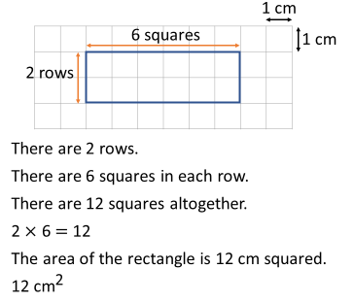
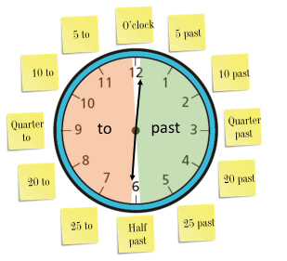
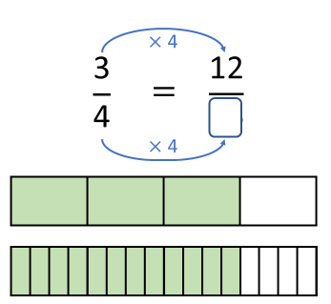
Why is it important to learn your times tables?
Knowing your times tables helps with….
Shape –finding the area
Telling the time – multiples of 5, 10, 15, 30, 6, 60
Fractions, decimals, percentages
Money – buying multiple items

Slide 13
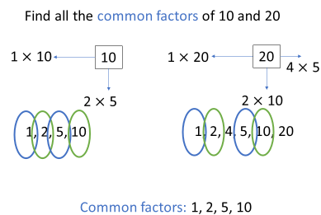
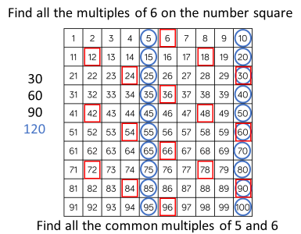
Why is it important to learn your times tables?
Knowing your times tables helps with….
Factors and multiples
Squares and cubed numbers
Related facts
Measures and ratio
2 x 3 = 6
20 x 3 = 60
200 x 3 = 600

Slide 14
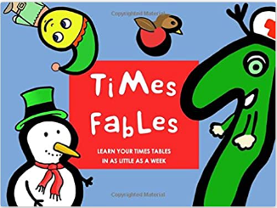
How can we prepare the pupils for the MTC?
Multiplication games
Daily recall tasks
Through songs / chants
Times table Rockstars
Using knowledge of key tables facts
Identifying patterns
Speed Grid Challenges
Display around house, including ceiling
Times Fables

Slide 15
TIMES TABLES ROCKSTARS
https://ttrockstars.com/login
At home and in-school learning platform
Get your child to practise daily for 15 minutes
Playing modes – soundcheck is closest in likeness to the test. The children need to have learnt all the tables to do this.

Slide 16
Games

Slide 17
Beat the buzzer
Set your stopwatch to 10 seconds to start with then gradually reduce it to 5 seconds
Ask for a multiplication fact – child can write it or say it – trying to beat the buzzer.
How fast can you answer 10 correctly?
Put the questions that are not answered correctly back in the pile – give the child the question cards that have been answered correctly . This helps them identify which facts need more learning and gives them repeated practice of those questions.

Slide 18
Multiplication pass
Active learning:
With a beach ball – or any ball – take it in turns to pass back and forth. Every time you or the child catches the ball, say the next multiple of the times table you are focusing on.
You could extend this to be mixed multiples where the person who passes the ball, calls a question as they throw the ball!

Slide 19
Multiplication treasure hunt
Place times table questions around the room/house to find and solve
When they get a correct answer, they look for the answer card to find the next question
All the answers could loop back some sort of a reward

Slide 20
Pairs
Place the question cards on side and the answer cards on the other.
Reveal one of each card to try and match them.
This can be played as a turn taking activity - trying to remember what each other has turned over. Who wins the most pairs?
This can also be played individually, against the clock. How fast can they match all the pairs?

Slide 21
Snap
For this to work, you would need multiple copies of the questions and answers in each pack.
One person holds the question cards, the other the answer cards
Place one of each down next to each other. Take it in turns to put a question or answer card down
Shout ‘snap’ if they make the correct number equation!
The winner for that round takes the matching pair and play continues

Slide 22
Tables (sweetie) pong
Set up three cups in a row
With three ping pong balls try to bounce them to land in the cups.
As they are trying to get the ping pong balls in the cups they have to say the times tables they are practicing repeatedly – they can only stop when a ball goes into a cup
When we play, we play sweetie pong so you get a reward at the bottom of the cup – 1, 2 or 3 sweets, depending on the distance away from them

Slide 23
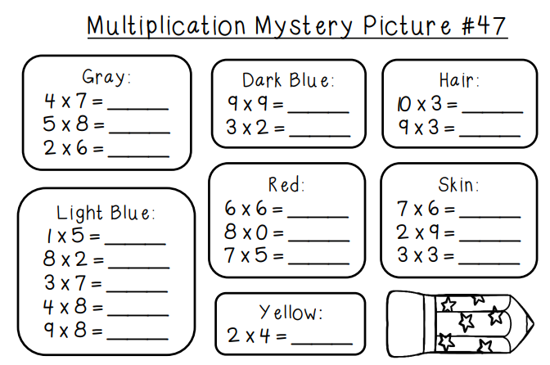
Mystery picture – colour and learn

Slide 24
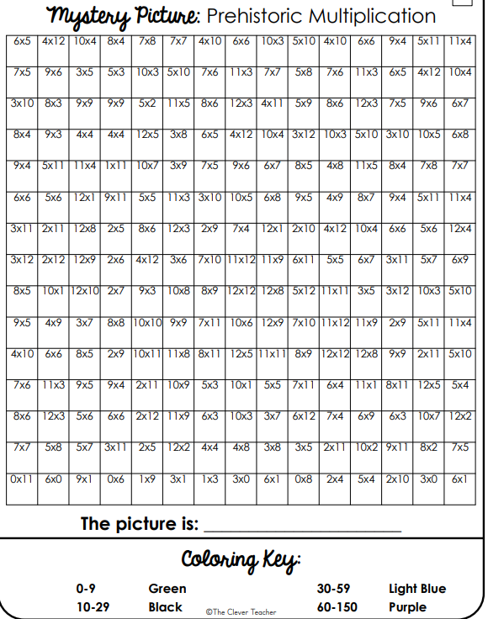

Slide 25
Times tables fortune tellers
Create the fortune tellers to have the multiplication equations they find hardest to remember in
Or
Create one for each times table

Slide 26
Games to adapt and have fun with
Dominoes
Ludo
Bingo
Frustration
Snakes and ladders

Slide 27
Times tables grids
Daily practice
Allow a time limit- how many can they answer? Maybe use a song as the timer – how many can they answer whilst listening to….
Set rules so they complete them in order – not avoiding the tricky ones!
Free printable resource – grids in order and random orders – there are more on this website:
https://www.math-salamanders.com/image-files/multiplication-times-table-chart-to-12x12-blank.gif
https://www.math-salamanders.com/image-files/blank-multiplication-charts-to-12x12-2.gif
https://www.math-salamanders.com/image-files/blank-multiplication-chart-to-12x12-3.gif

Slide 28
Songs
Numberock website (https://numberock.com/ ), numberjacks or through youtube – Percy Parker songs are fun!
X2 https://www.youtube.com/watch?v=FkAzZoqCJ4E
X3 https://www.youtube.com/watch?v=jJG4ZgJTOAs
X 4 https://www.youtube.com/watch?v=UJY1_fzzM6Y
X 5 https://www.youtube.com/watch?v=LZAqhF_2vvs
X6 https://www.youtube.com/watch?v=e7rYbk9PNuM
X 7 https://www.youtube.com/watch?v=wwekMIqb55s
X8 https://www.youtube.com/watch?v=dSnNkgMbtfs
X9 https://www.youtube.com/watch?v=154VoUQbgvc
X 10 https://www.youtube.com/watch?v=5kwIccQGcr0
X11 https://www.youtube.com/watch?v=p9AxbcO4Kp4
X12 https://www.youtube.com/watch?v=PABb8HhmteM

Slide 29
Resources available to purchase and use
Please see the resources around the room that you may want to buy to support your children
Games
Mats
Displays
Packaging to ‘notice’ – egg trays 3s 6s

Slide 30
Useful Websites
SCHOOL WEBSITTE – numbers count workshops available
COOL MATHS https://www.coolmathgames.com/1-number-games
IXL HTTPS://UK.IXL.COM/
TIMES TABLES ROCK STARS HTTPS://TTROCKSTARS.COM/
TOPMARKS HTTPS://WWW.TOPMARKS.CO.UK/
DFE VIDEO - HTTPS://YOUTU.BE/GHAJMJUSAAC
HIT THE BUTTON- https://www.topmarks.co.uk/maths-games/hit-the-button

